Slide 1
Food Saver
Brian Franklin, Dang Truong, Elijah Tate, and Prahalad Muralidharan

Slide 2
Quick overview of Food Saver
Platform to allow food suppliers to register and sell their soon to expire food a low cost
Users can see food products, as well as their location

Slide 3
Use case diagram for Customer (Next Slide)

Slide 4
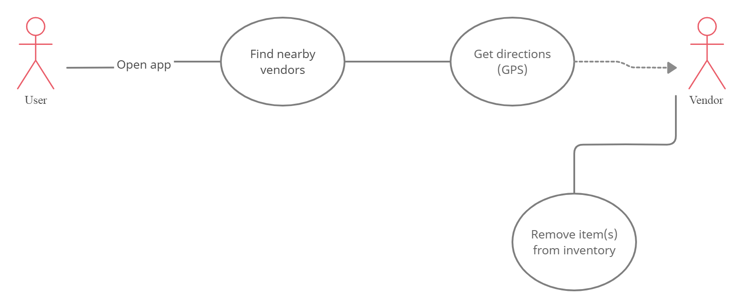

Slide 5
Use case diagram for Vendor (Next Slide)

Slide 6
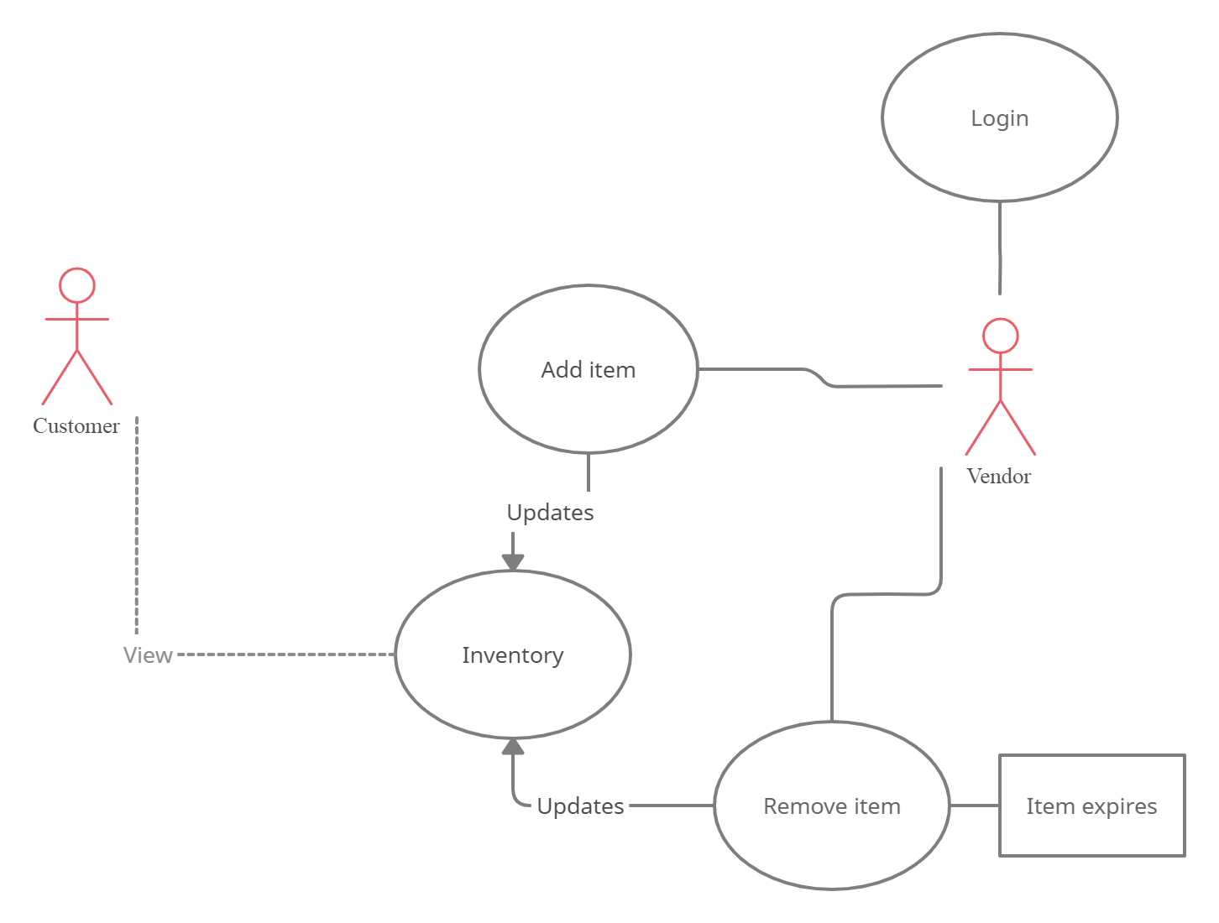

Slide 7
Test Case Scenario #1
The user is trying to find his vendors by gps and let's say we have 4 vendors in order A,B,C,D. vendor A - medium distance but offering cheapest price, B - far distance but offering cheapest price, C - low distance but most expensive price, D - medium but expensive price. The gps will show the user the vendors and the vendors can be sorted by either distance or price.

Slide 8
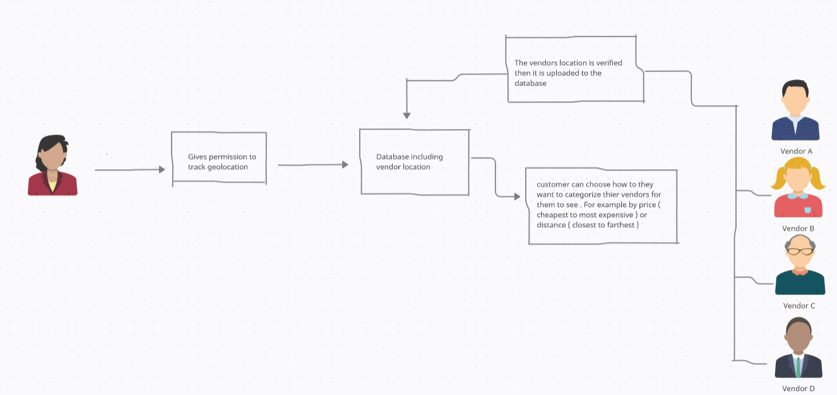
Test case scenario diagram geo location

Slide 9
Test Case Scenario #2
The user (vender) has 5 burgers and he/she has sold one burger on monday and one burger has gone bad on tuesday and on wednesday he/she made another burger. Thursday is her inventory day and she has to update it so she has to enter her losses and gains and quality of each burger and if it goes bad, she will have to update that or update how long a burger is good for. Then the database or storage will update the info and present it to the customers accordingly.

Slide 10
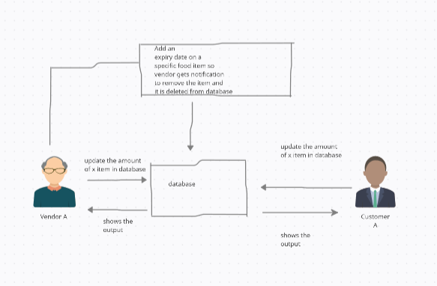
Test case diagram updating inventory

Slide 11
UML Sequence Diagram (Next Slide)

Slide 12
